Slide 1
Artificial Intelligence Assignment #2

Slide 2
Assignment #2
Due date: Friday, 24, March 2017, 11:55 pm
- No late submission.
Submit in YSCEC → Assignment #2
Make report(ppt file) explaining your algorithm method.
ppt => within 4 page.
Change your file name to be your university number.

Slide 3
Assignment #2
This assignment is almost similar to assignment #1.
Use self.problem.checker(x, y, value)
Some display fields are added on the bottom part of the UI
Count field displays the total times of checker function used.

Slide 4
Purpose
Minimize the number of counter.
In Sudoku, All possible solution is about 6*(10^21)
Lower bound : 81
when just use “for loop” : 404~406

Slide 5
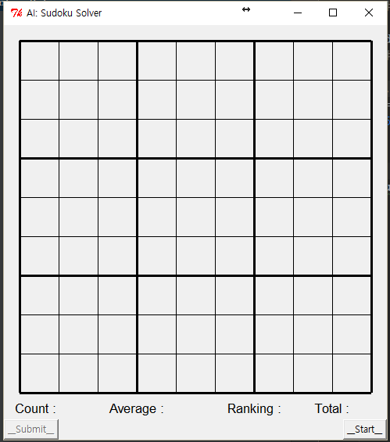
UI
Solve 100 problem.
Start

Slide 6
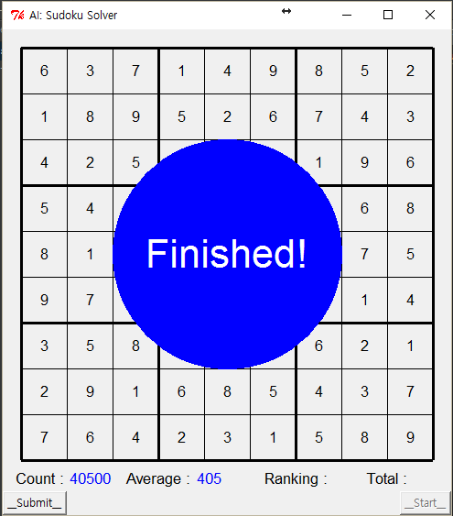
UI
You can use “this button”
in one time for 10 minutes
Submit

Slide 7
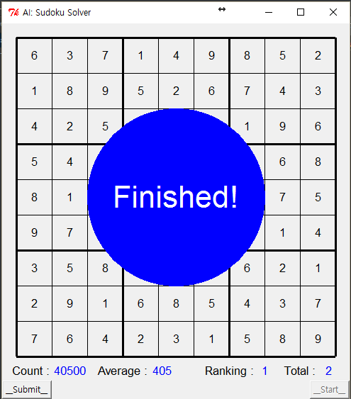
UI
“Total” displays the total
number of student submitted
up to present

Slide 8
DEMO

Slide 9
Assessment
Full score is 20 points in assignment #2.
- Algorithm : 10 points (50%)
- Ranking : 5 points (25%) ( under absolute evaluation )
- Power point file : 5 points (25%) ( how well-explained )
Bonus score : If you present your algorithm in next class, we give you 5 extra point. ( if you want, send me an email )

Slide 10

Need to do
Write your University Number & Password (your phone number in YSCEC)
Create a zip file that includes ppt file and code (assignment.py).
Rename assignment.py file to 20121111111.py (university number)
Also rename your zip file. (20121111111.zip)

Slide 11
Do Not !
Do not access problem class. ( only use solver class )
Do not store given problems.
Do not try to submit in the name of other student.
Do not copy code other made.

